Slide 1


Solutions Available in Azure Logic Apps & Cognitive Services
Glen Tsime
Azure Solutions Specialist

Slide 2
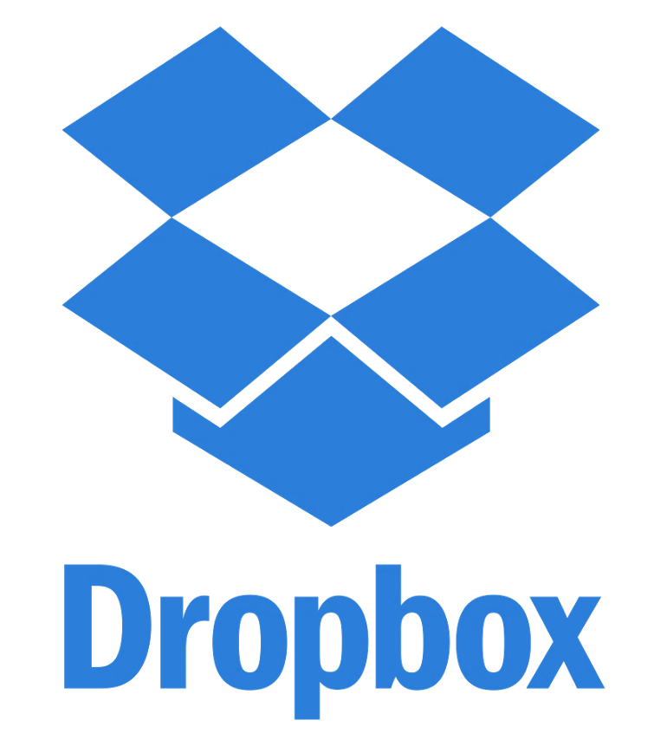




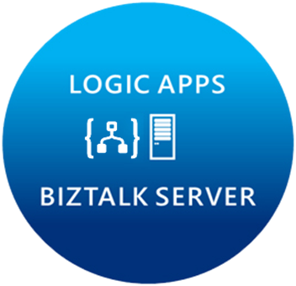
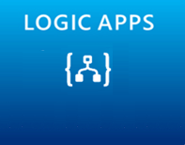



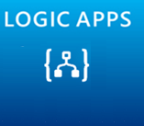








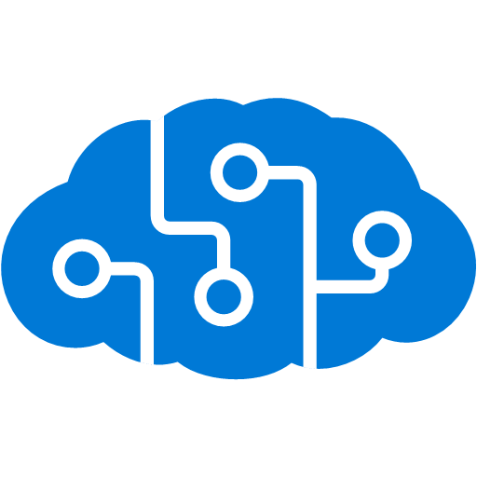


Microsoft’s Cloud Integration Platform
About 39% of developers are focused on building cloud based Application integration
API MANAGEMENT
AZURE SERVICES
IoT/Event Hub
Azure Search
SQL Database
CONNECTORS
AZURE SERVICES
AZURE SERVICE BUS
DocDB
BLOB Storage
Functions
API MANAGMENT
Machine Learning
HD Insight
Site Recovery
B2B/EDI
Tables
Cognitive Services
DNS

Slide 3
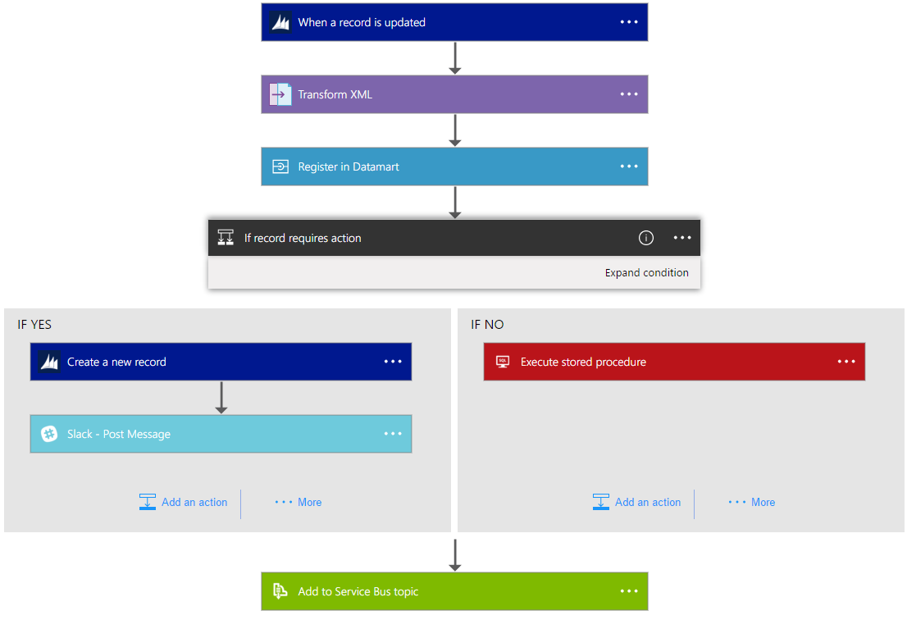
Introducing Azure Logic Apps
Powerful Integration. Hyperscale Workflow Engine, born in Azure
Faster integration using innovative Visual Designer
Easy workflow creation with triggers and actions
Mashup applications, data and services
Built for mission critical Enterprise Integration
Create, deploy, manage and monitor

Slide 4
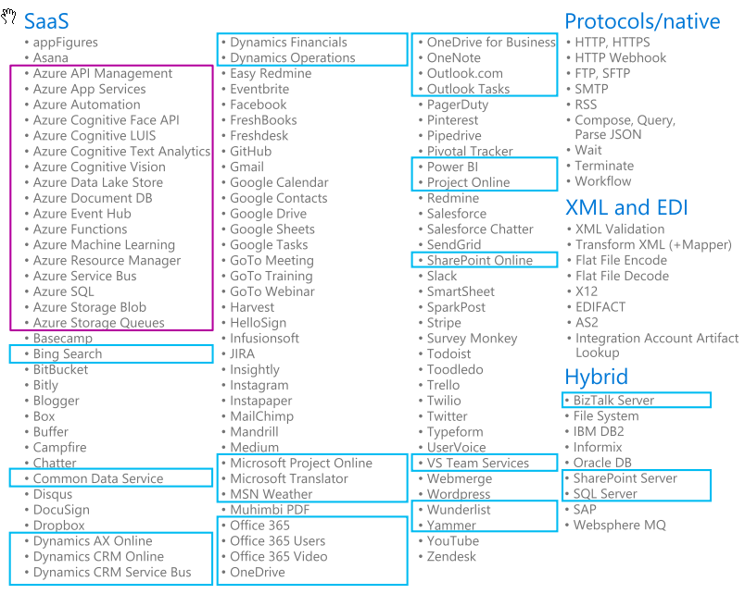
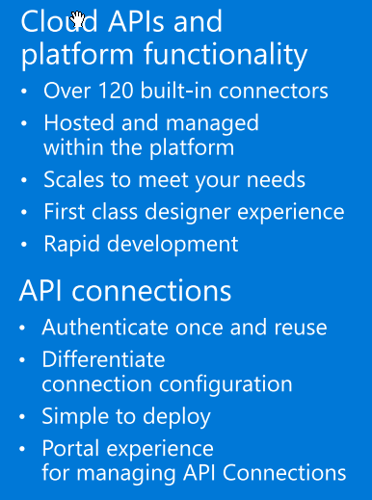
Logic Apps Connectors (120+)

Slide 5

Cognitive Services
Vision
From faces to feelings, allow your apps to understand images and video
Microsoft Cognitive Services
Give your apps a human side
Speech
Hear and speak to your users by filtering noise, identifying speakers, and understanding intent
Language
Process text and learn how to recognize what users want
Knowledge
Tap into rich knowledge amassed from the web, academia, or your own data
Search
Access billions of web pages, images, videos, and news with the power of Bing APIs

Slide 6
Search
Vision
Speech
Language
Knowledge
Bing Web Search
Computer Vision
Bing Speech
Bing Spell Check
Bing Web Search
Bing Spell Check
Academic
Knowledge
Bing Custom Search
Bing Custom Search
Custom Vision Service
Custom Speech Service
Linguistic Analysis
Custom Decision Service
Bing Image Search
Bing Image Search
Emotion
Speaker Recognition
Language Understanding
Knowledge Exploration
Bing Video Search
Bing Video Search
Face
Translator
Text Analytics
QnA Maker
Bing News Search
Bing News Search
Video
WebLM
Recommendations
Bing Autosuggest
Bing Autosuggest
Video Indexer
Entity Linking
Content Moderator
microsoft.com/cognitive

Slide 7
DEMO

Slide 8
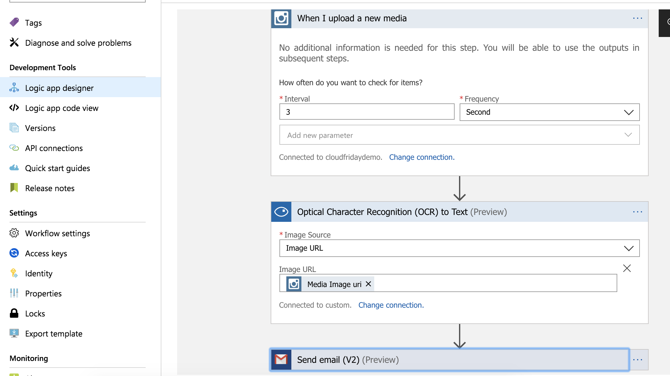

Slide 9
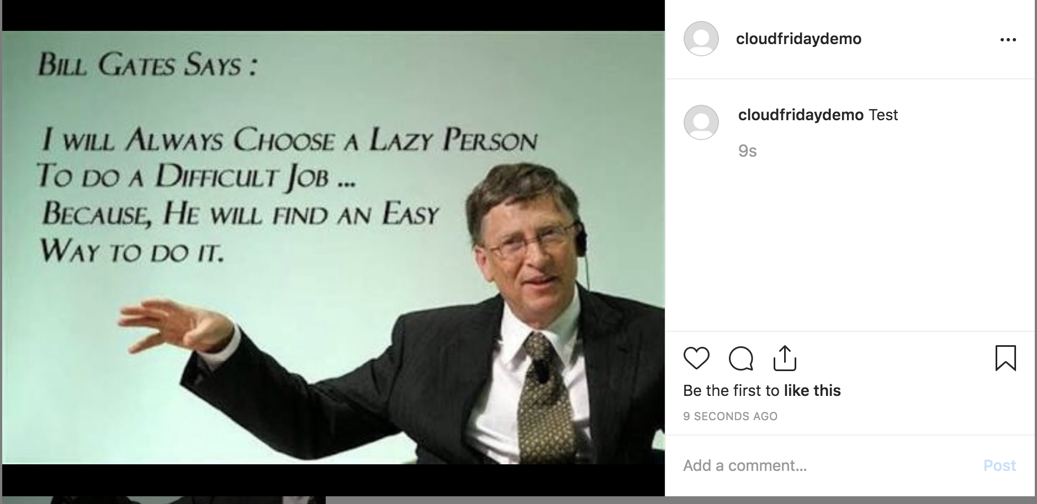

Slide 10
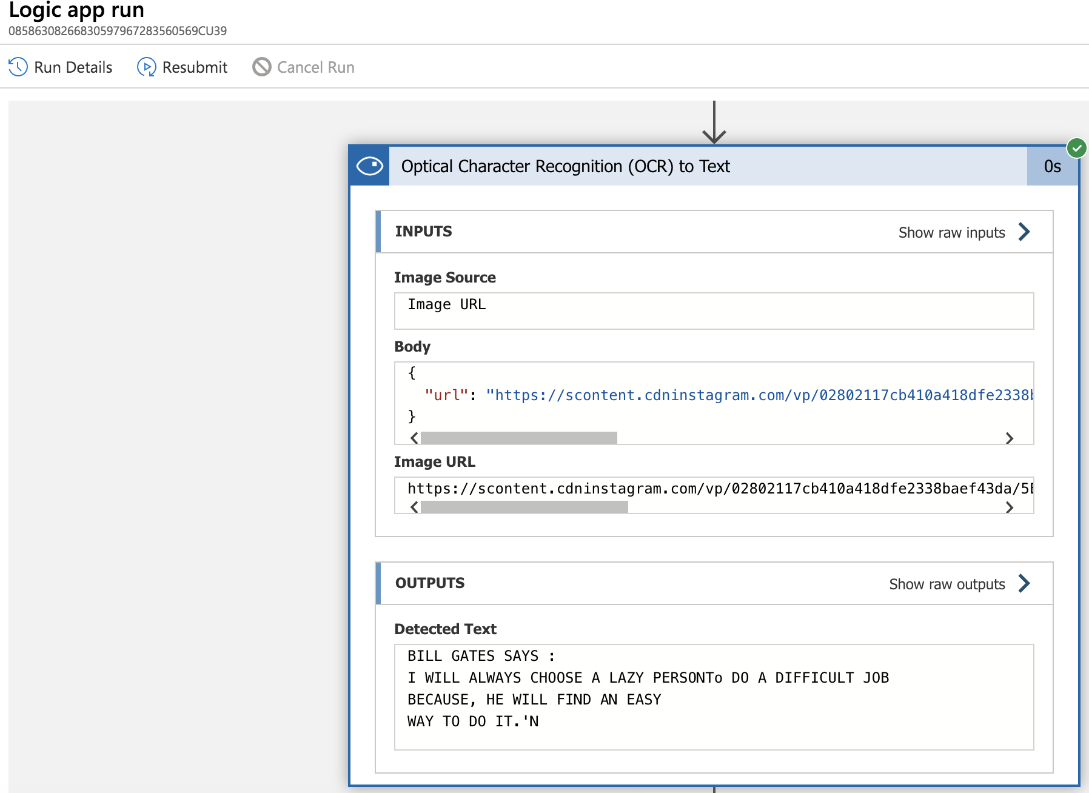

Slide 11
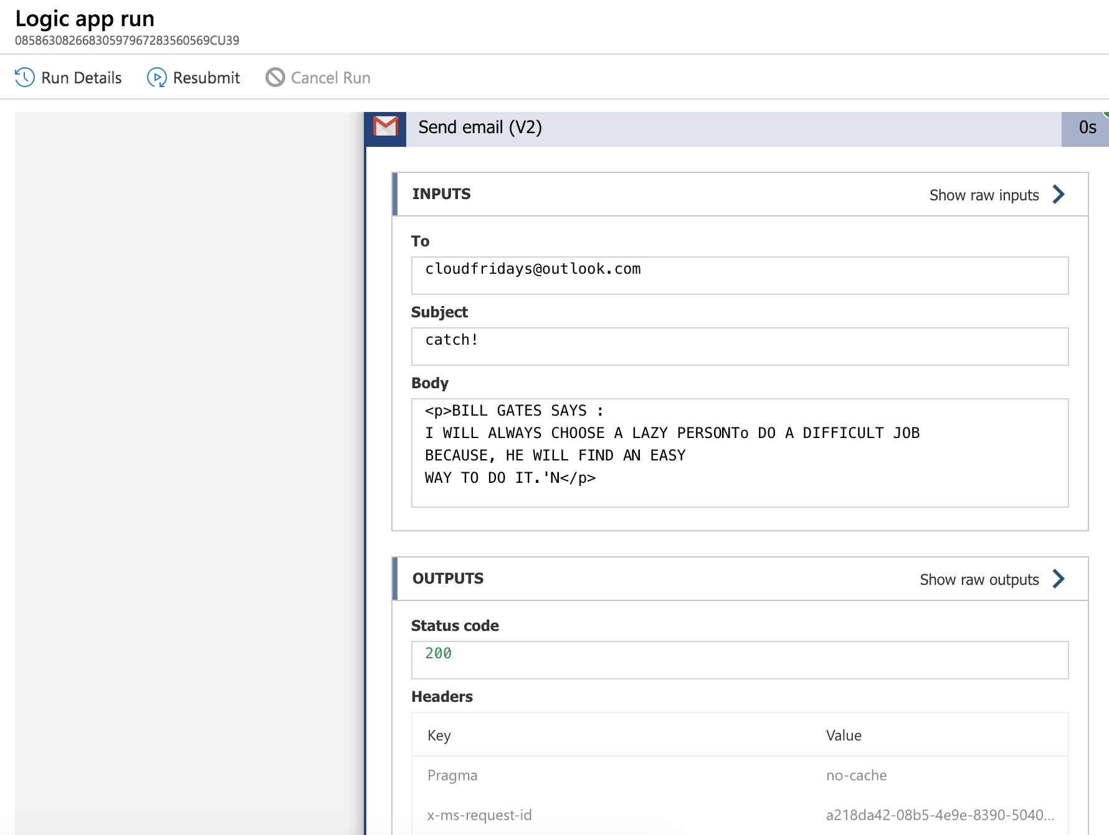

Slide 12
THANK YOU!
Logic Apps & Cognitive Services
Glen Tsime
Azure Solutions Specialist

Slide 13
Solutions Available on Azure
AI & ML, DevOps
Thomas Van Niekerk

Slide 14
What is Artificial Intelligence?
Techniques that enables computers to mimic human intelligence,
using logic, if-then rules, decision trees and machine learning.

Slide 15
What is Machine Learning ?
Using known data, developing a model to predict unknown data.
Improving tasks with experience.
Deep Learning using algorithms that is permitting software to train itself to perform tasks, exposes neural networks to vast amounts of data
Notes:
Machine learning is a data science technique that allows computers to
use existing data to forecast future behaviours, outcomes, and trends.
DL = speech and image recognition

Slide 16
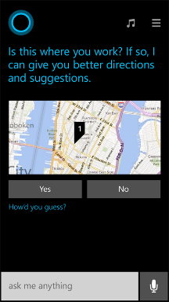
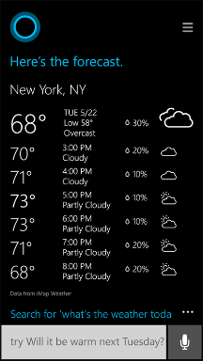
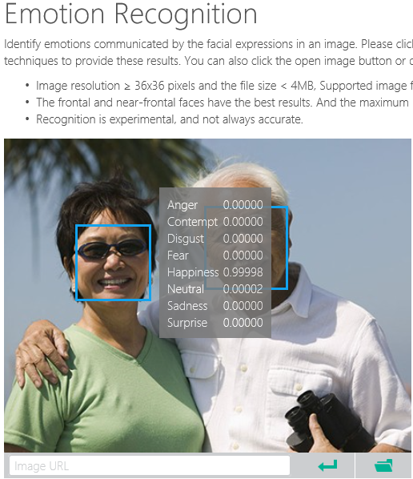
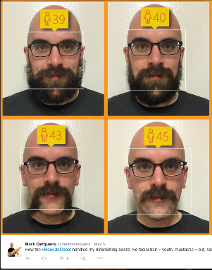

Why/Where/When do we use AI or ML?
Notes:
Smart applications, services, platforms…
Digital Smart Personal Assistant
Image / Text / Data analyze

Slide 17
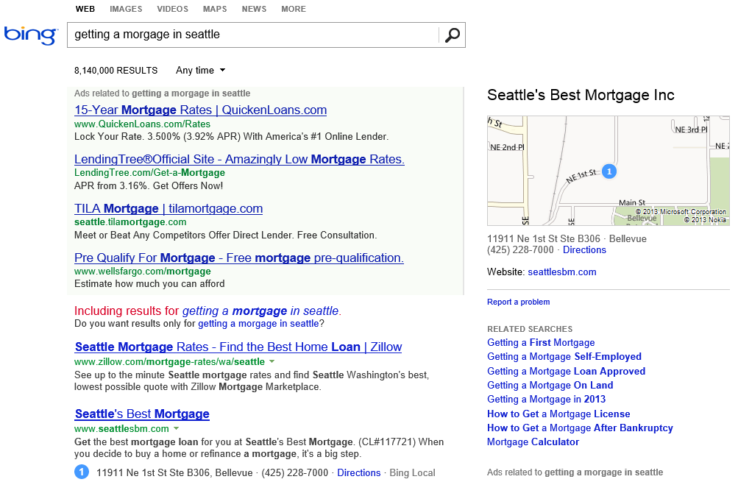
What is the probability of a click on each ad?
What language?
What is the intent?
Machine learning enables nearly every value proposition of web search.
Which ads to show, and in what order?
Are any of these pages malicious?
Misspelled?
What pages should we index?
What ad pricing will optimize revenue?
Which links are most likely to get clicked?
Notes:
The first “killer commercial application” of ML on Big Data was web search. With ML, we can use all of the billions of queries and associated clicks that we collect each month as training data for an ML system. That way, the system can learn, for each query, which web pages are likely the most relevant.
But the impact of ML goes beyond page relevance. With billions of queries, we can learn common misspellings and the native language of the user. We can discern the intent of the user – shopping? research? entertainment? ML can learn what kinds of pages are malicious.
ML also is able to learn, for each query, what kinds of ads are most likely to be clicked, and also learn how best to show the ads.
And even before we get to a real user, ML can be used to figure out what parts of the web are worth scanning, and what pricing for ads will optimize revenues.

Slide 18


Data Science
Data Science is far too complex
Cost of accessing/using efficient ML algorithms is high
Comprehensive knowledge required on different tools/platforms to develop a complete ML project
Difficult to put the developed solution into a scalable production stage
Need a simpler/scalable method
Azure Machine Learning Service
Notes:
Actually it is the science on data
WHAT IS AZURE MACHINE LEARNING SERVICE?
Set of Azure Cloud Services + Python SDK
✓ Prepare Data
✓ Build Models
✓ Train Models
✓ Manage Models
✓ Track Experiments
✓ Deploy Models

Slide 19

Microsoft Azure Machine Learning
Make machine learning accessible to
Every enterprise, data scientist, developer,
Information worker, consumer, and
device anywhere in the world.

Slide 20
From data to decision and then action
Data
Recommendations
What should I do?
Decision
Action
Decision automation
Decision support
Predictions
What will happen?
Interactive dashboards
Why did it happen?
Static reports
What happened?
Manual process
Value
Notes:
Machine Learning Studio
Azure Machine Learning solution you’ve grown to love.
Machine Learning Studio is a powerfully simple browser-based,
visual drag-and-drop authoring environment
no coding is necessary.
Go from idea to deployment in a matter of clicks.

Slide 21
Microsoft Azure Machine Learning
Built for a cloud-first, mobile-first world
Fully managed
Integrated
Flexible
Deploy in minutes
No software to install, no hardware to manage, all you need is an Azure subscription.
Drag, drop and connect interface. Data sources with just a drop down; run across any data.
Built-in collection of best of breed algorithms with no coding required. Drop in custom R or use popular CRAN packages.
Operationalize models as web services with a single click. Monetize in Machine Learning Marketplace.
Notes:
Machine Learning Studio
, the Azure Machine Learning solution you’ve grown to love.
Machine Learning Studio is a powerfully simple browser-based,
visual drag-and-drop authoring environment where
no coding is necessary.
Go from idea to deployment in a matter of clicks.

Slide 22
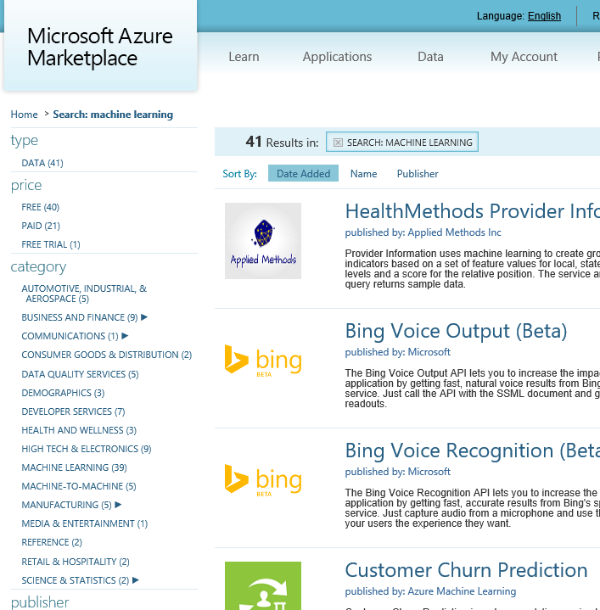
API examples
Green Score, Wealth Score, Giving Score
Frequently Bought Together API
Recommendations API
Anomaly Detection API
Lexicon Based Sentiment Analysis
Forecasting: Exponential Smoothing
Forecasting: ETS+STL
Forecasting: AutoRegressive Integrated Moving Average (ARIMA)
Binary Classifier API
Cluster Model API
Survival Analysis API
Multivariate Linear Regression API
Survival Analysis API
Multivariate Linear Regression API
Normal Distribution Quantile Calculator
Binomial Distribution Quantile Calculator
And more on datamarket.azure.com
Notes:
Machine Learning Studio
, the Azure Machine Learning solution you’ve grown to love.
Machine Learning Studio is a powerfully simple browser-based,
visual drag-and-drop authoring environment where
no coding is necessary.
Go from idea to deployment in a matter of clicks.

Slide 23
How to start Machine Learning
Azure Machine Learning Studio
Browser-based, visual drag-and-drop authoring environment
No coding
Notes:
Machine Learning Studio
Azure Machine Learning solution you’ve grown to love.
Machine Learning Studio is a powerfully simple browser-based,
visual drag-and-drop authoring environment
no coding is necessary.
Go from idea to deployment in a matter of clicks.

Slide 24
Machine Learning Studio
Platform for emerging data scientists to graphically build and deploy experiments.
Rapid experiment composition
100’s easily configured modules for data prep, training, evaluation
Extensibility through R & Python
Serverless training and deployment
Some numbers:
100’s of thousands of deployed models serving billions of requests

Slide 25
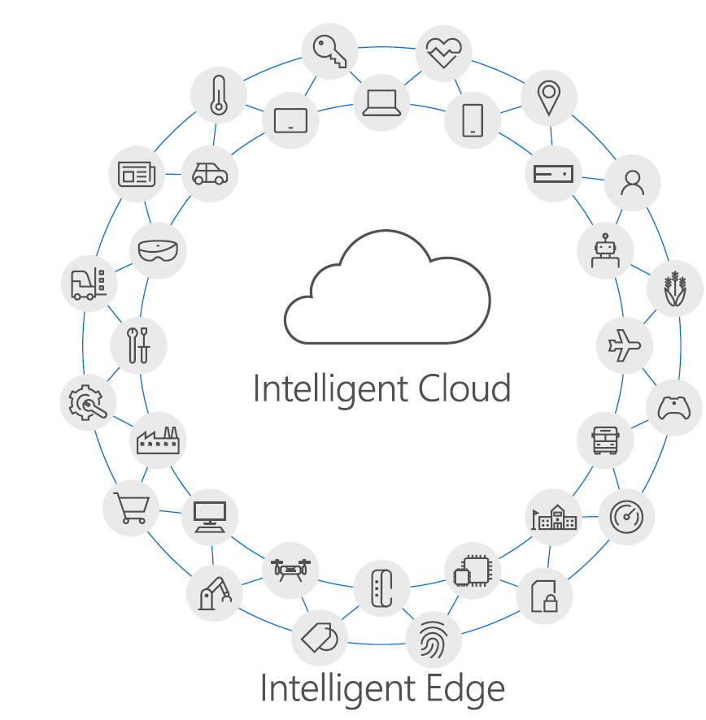
Why Intelligent Edge?
High-speed data processing, analytics and shorter response times are more essential than ever.
Intelligent Cloud
Business agility and scalability: unlimited computing power available on demand.
Intelligent Edge
Can handle priority-one tasks locally even without cloud connection.
Can handle generated data that is too large to pull rapidly from the cloud.
Enables real-time processing through intelligence in or near to local devices.
Flexibility to accommodate data privacy related requirements.

Slide 26
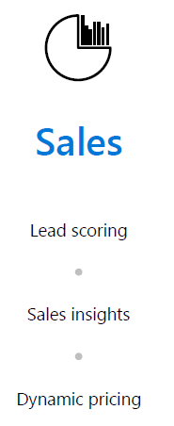
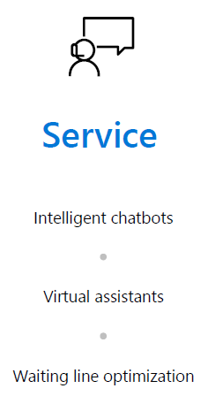
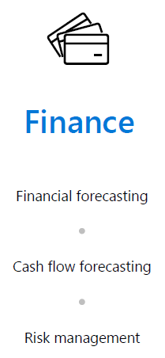
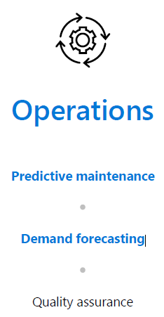
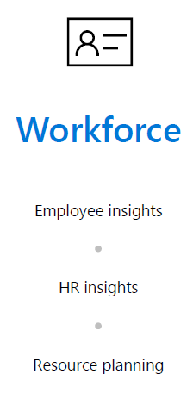
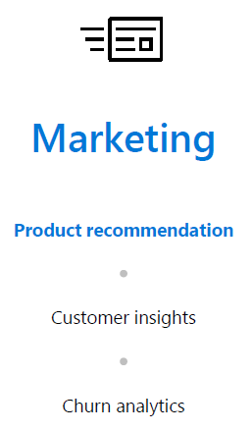
Innovate Across Your Business

Slide 27

Recap
Notes:
https://channel9.msdn.com/Blogs/Azure/Azure-Machine-Learning/player?format=ny

Slide 28
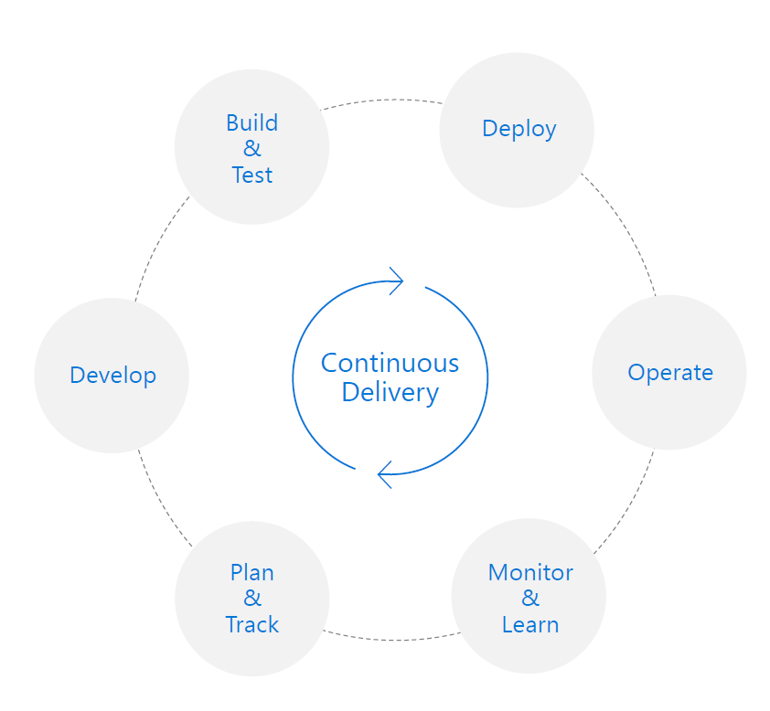
Azure DevOps & Azure DevTest Labs
What is DevOps?
People. Process. Products.
“DevOps is the union of people, process, and products to enable continuous delivery of value to your end users. ”

Slide 29
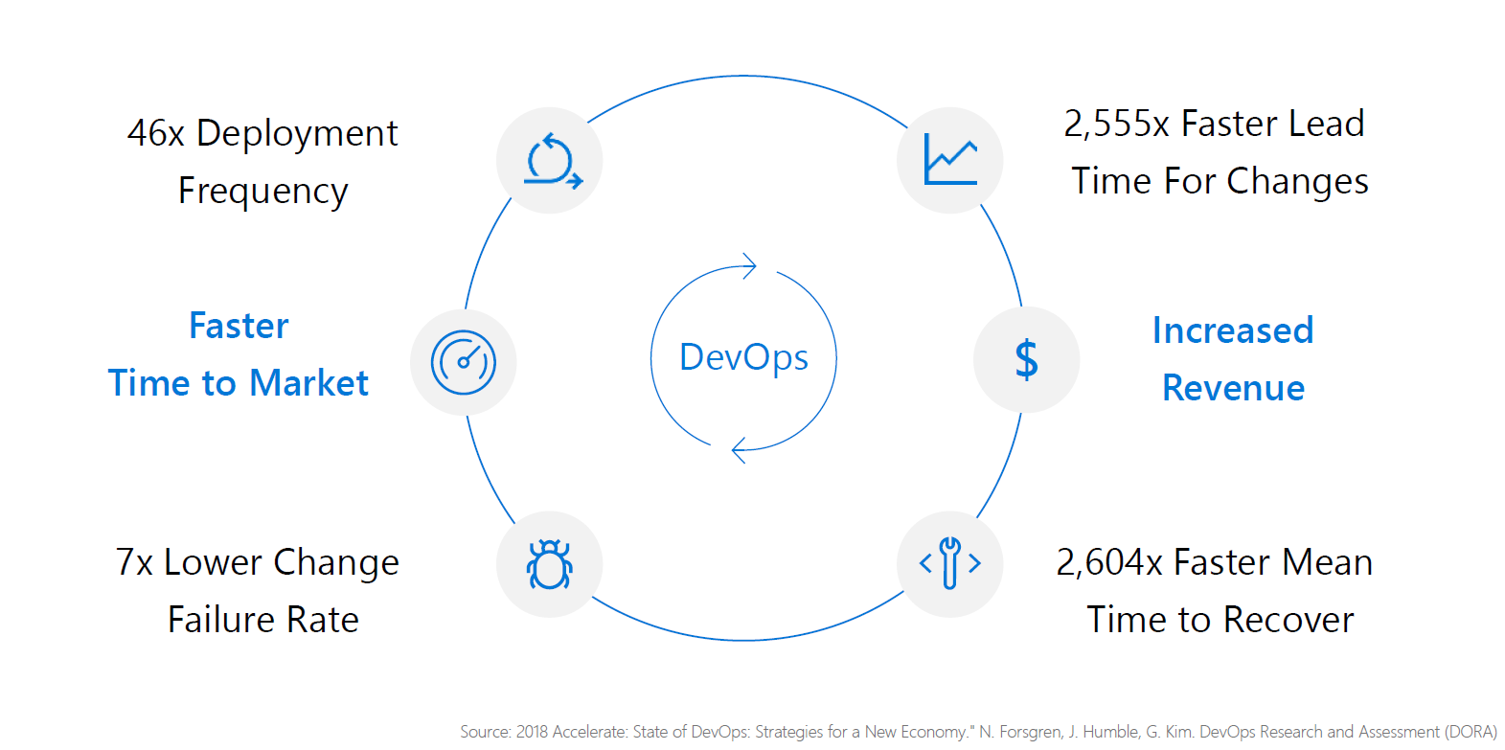
What can a High Performance DevOps Company Achieve?

Slide 30
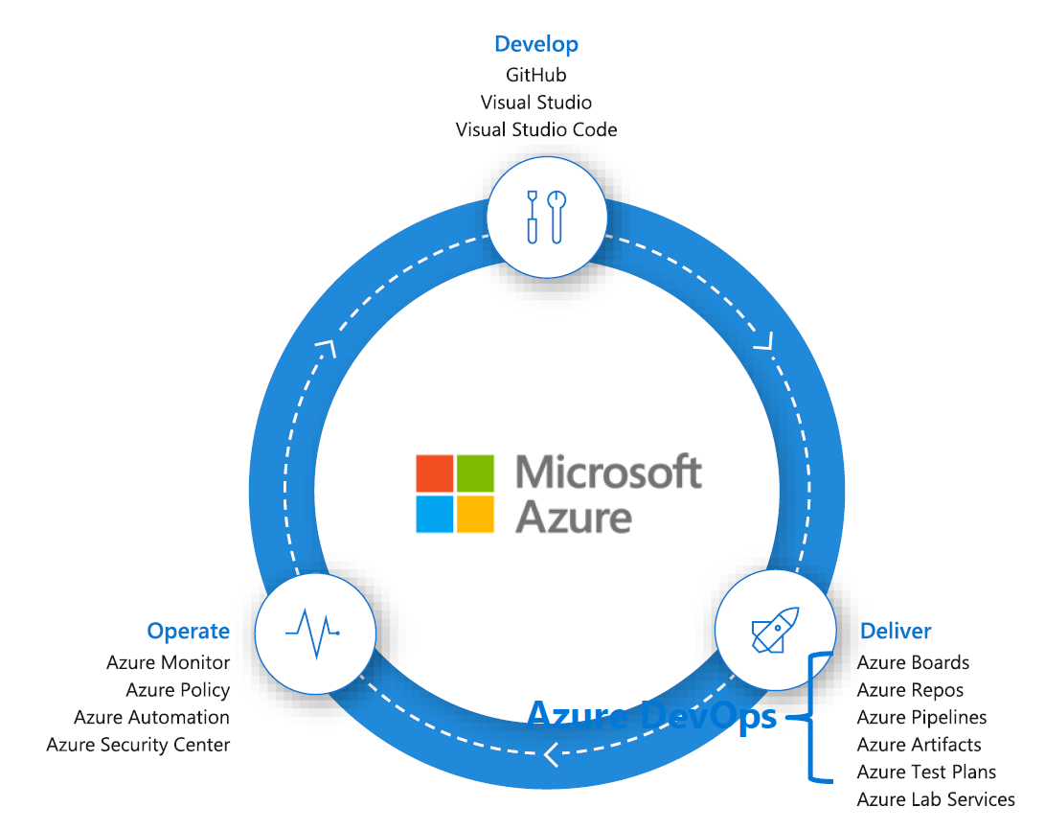
Introducing Azure DevOps & Azure DevTest Labs
Microsoft Azure is the cloud with DevOps tooling built in

Slide 31

Let’s Clear Up a few confusions!
Q. Does Azure DevOps require an Azure subscription?
A. No!
Q. Will Azure DevOps work with non-Microsoft technologies?
A. Yes!
Q. Will Azure DevOps work with AWS or GCP?
A. Yes!
Q. How about open source (OSS)?
A. Yes!

Slide 32
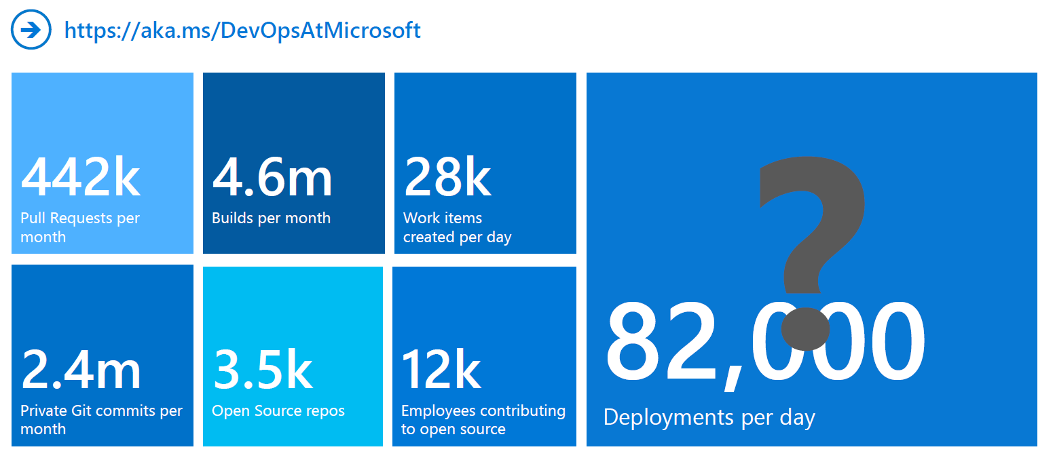
DevOps at Microsoft
Azure DevOps is the toolchain of choice for Microsoft engineering with over 100,000 internal users

Slide 33
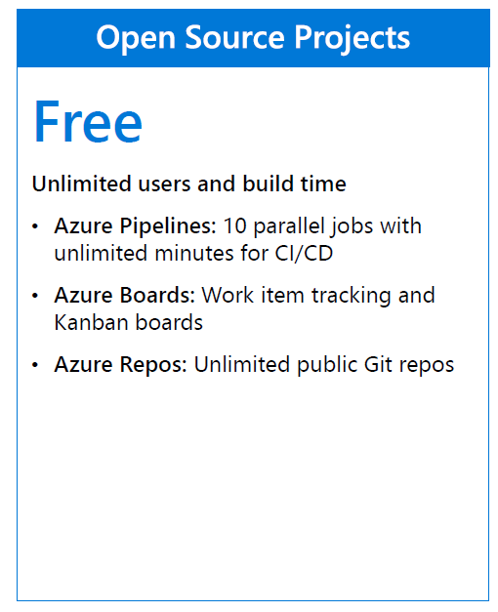
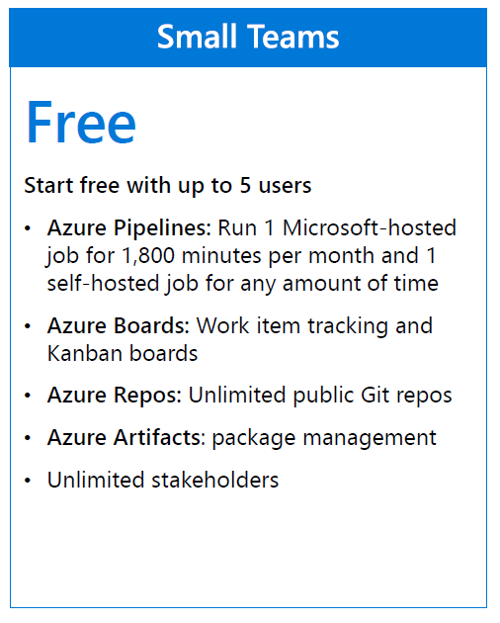
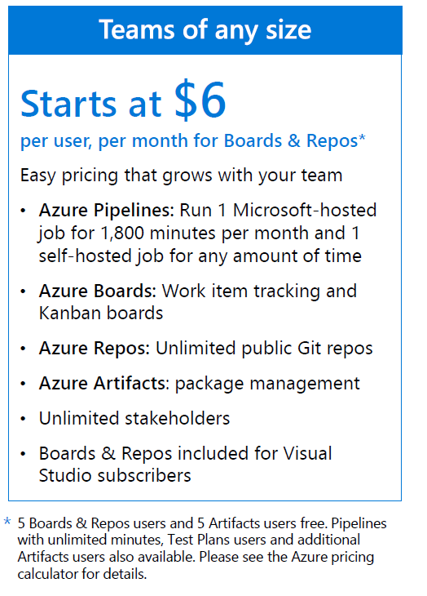

Azure DevOps Services Pricing
Notes:
https://azuredevopsdemogenerator.azurewebsites.net/

Slide 34
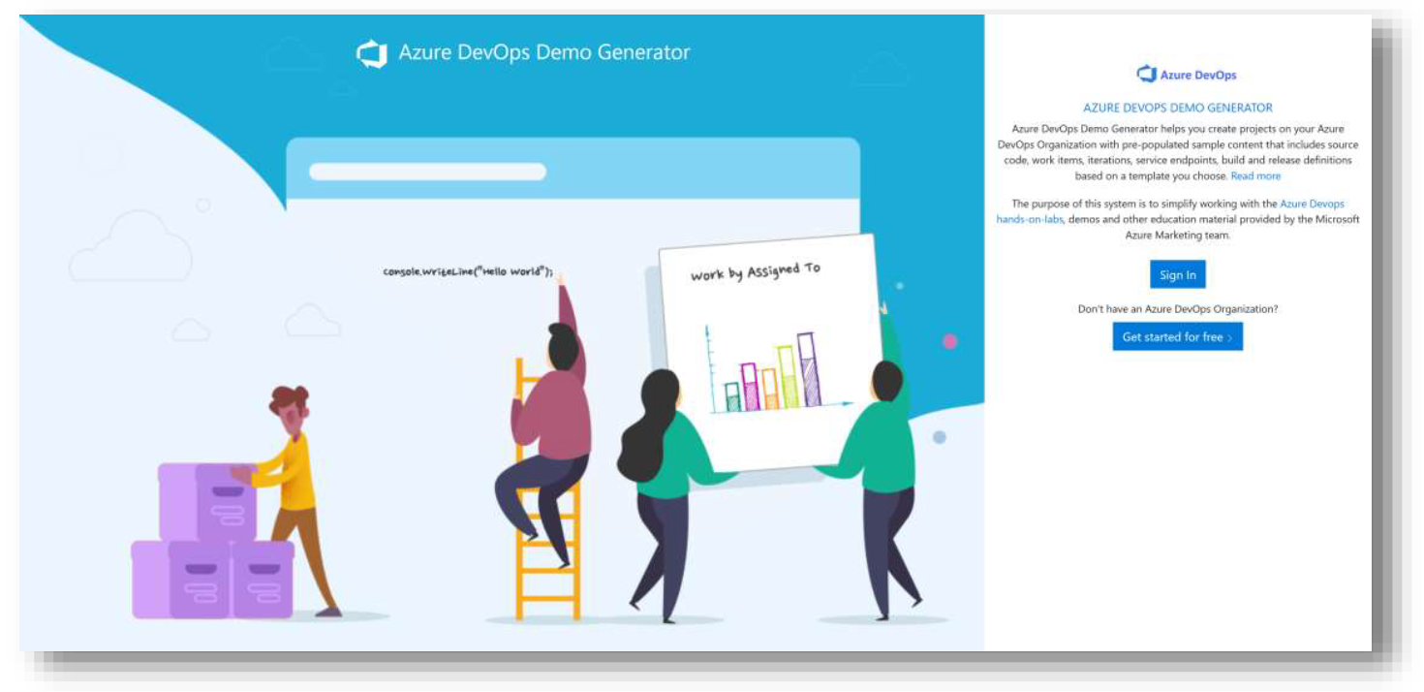
Azure DevOps Demo Generator
Notes:
https://azuredevopsdemogenerator.azurewebsites.net/

Slide 35

Recap

Slide 36
THANK YOU!
AI & ML, DevOps
Thomas Van Niekerk

